Slide 1
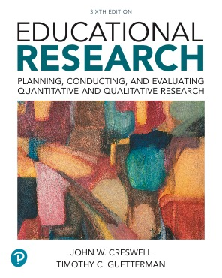
Educational Research: Planning, Conducting, and Evaluating Quantitative and Qualitative Research
Sixth Edition
Chapter 1 The Process of Conducting Research Using Quantitative and Qualitative Approaches
Chapter 2 Identifying a Research Problem
Chapter 3 Reviewing the Literature
Copyright © 2019, 2015, 2012 Pearson Education, Inc. All Rights Reserved
Notes:
If this PowerPoint presentation contains mathematical equations, you may need to check that your computer has the following installed:
1) MathType Plugin
2) Math Player (free versions available)
3) NVDA Reader (free versions available)

Slide 2
What is Research?
The researcher poses a question.
The researcher collects data to answer the question.
The researcher presents an answer to the question.

Slide 3
Importance of Research
Reason 1: Research adds to our knowledge.
  Addresses gaps in knowledge
  Expands knowledge
  Replicates knowledge
  Adds voices of individuals to knowledge
Reason 2: Research helps improve practice.
  Educators gain new ideas for their job.
  Educators gain new insights into approaches.
  Educators can connect with other educators.
Reason 3: Research helps inform policy debates.
  Research allows people to weigh different perspectives on issues.
  Research enables people to make informed decisions regarding policy.

Slide 4
Problems with Research Today
Contradictory or vague findings
Questionable data
Unclear statements about the intent of the study
Lack of full disclosure of the data collection procedure
Inarticulate rendering of the research problem

Slide 5
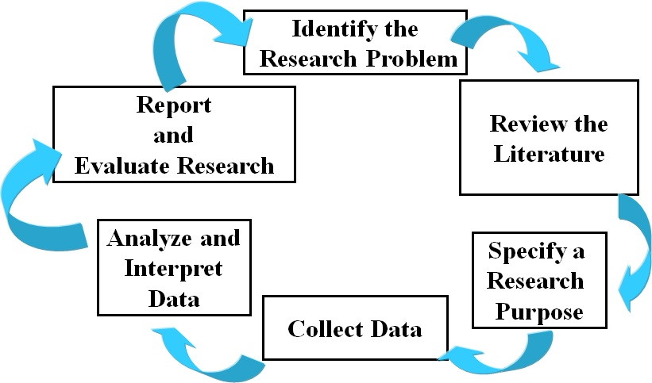
Figure 1.2 The Research Process Cycle
Notes:
The cycle of the six step research process

Slide 6
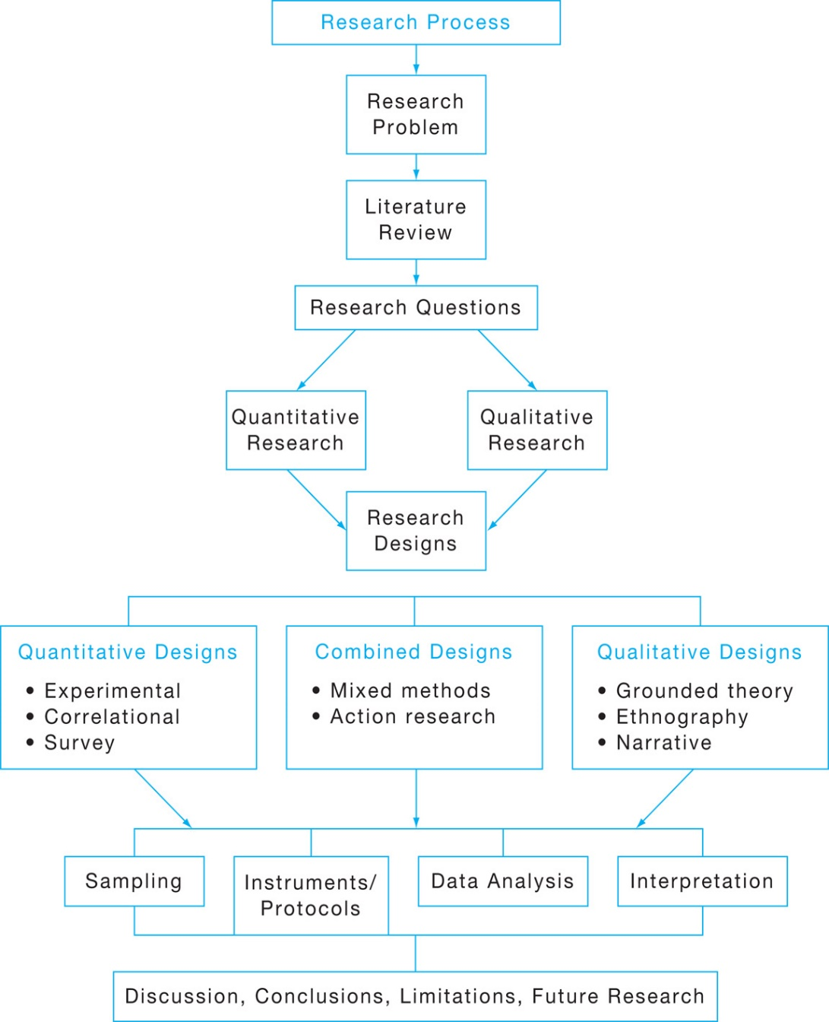
Figure 1.3 Flow of the Research Process through Quantitative and Qualitative Research
Notes:
Figure of the research process including designs

Slide 7
Similarities between Quantitative and Qualitative Research
Both follow the six steps in the process of research
Both have introductions that establish the importance of the research problem
Both use interviews and observations

Slide 8
Differences between Quantitative and Qualitative Research
Quantitative research problems direct hypotheses and questions; Qualitative problems establishes importance
Quantitative data collection is more closed-ended; Qualitative more open-ended
Quantitative data analysis is based on statistics; Qualitative analysis based on text or image analysis
Quantitative reporting has a set structure; Qualitative reporting is more flexible
Different points on a continuum

Slide 9
Important Ethical Issues in Conducting Research
Learn to apply for approval from your institutional review board
Recognize guidelines from professional associations
Use ethical practices throughout research
Use respectful data collection procedures
Show respect to audiences who read and use research

Slide 10
What is a Research Problem and Why is it Important? (1 of 3)
Research problem:
Educational issues
Controversies
Concerns
Guide the need for conducting a study

Slide 11
How Does the Research Problem Differ from Other Parts of Research
A research topic is the broad subject matter being addressed in a study.
A research problem is an educational issue or problem addressed in the study.
A purpose is the major intent or objective of the study.
Research questions are those that the researcher would like answered or addressed in the study.

Slide 12
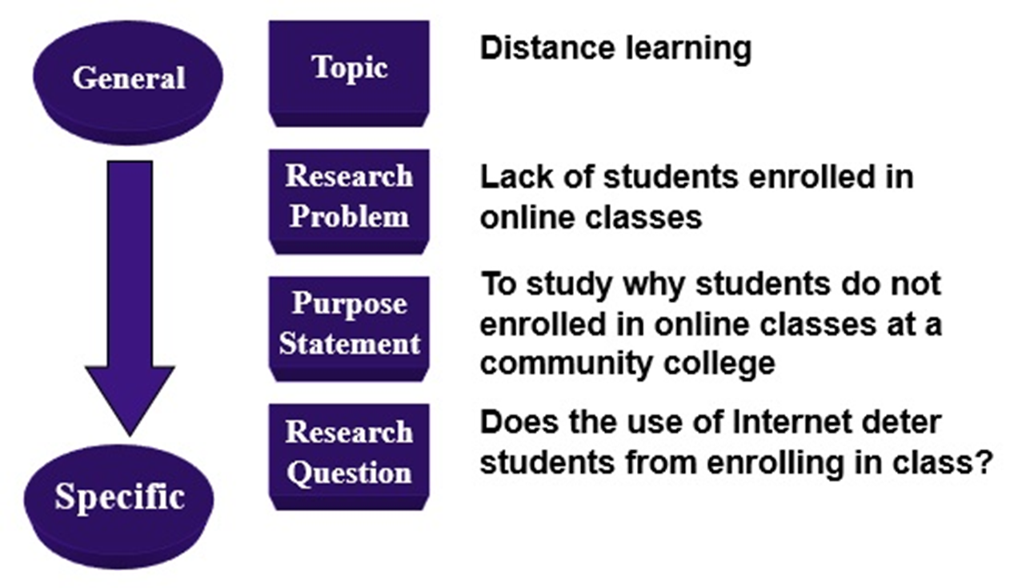
Figure 2.1 Distinguishing Among the Topic, Problem, Purpose, and Research Questions

Slide 13
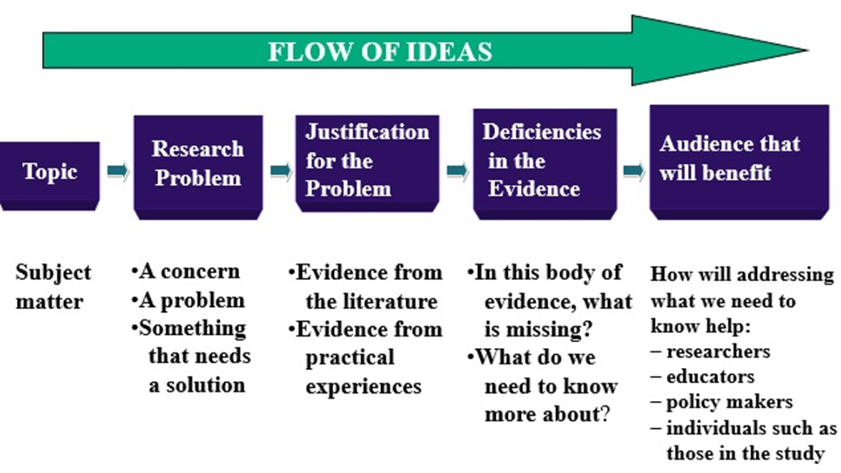
How Do You Write A “Statement of the Problem” Section? (1 of 7)

Slide 14
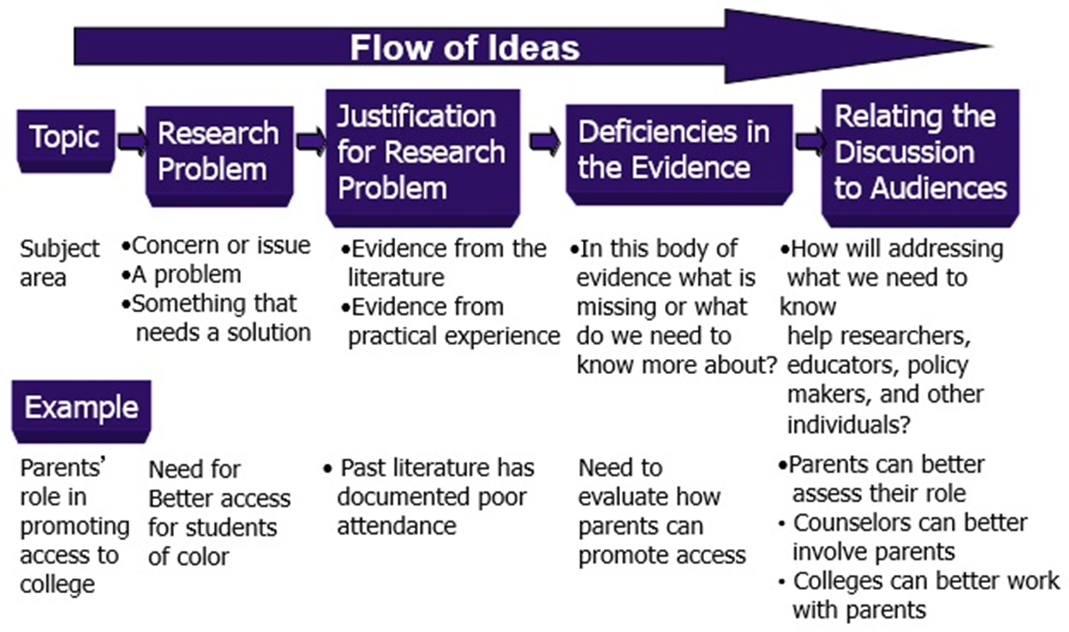
Example of the Flow of Ideas in the Problem Statement

Slide 15
What is a Literature Review and Why is it Important?
A written summary of the literature
Describe past and current information and research
Organize into subtopics
Base mainly on research reported in journal articles
Document how your study adds to literature

Slide 16
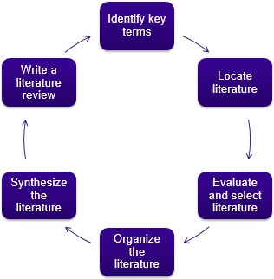
What Are the Six Steps in Conducting a Literature Review?

Slide 17
Six Step Literature Review: Locate the Literature
Use academic library sources
  Peer-reviewed articles
  Textbooks
  Be cautious of Wikipedia
Primary and secondary sources

Slide 18
Six Step Literature Review: Locate the Literature
Databases that index journal articles
  Social Science Citation Index
  E B S C O
  Google Scholar
  Dissertation Abstracts
  E R I C
  Psyc INFO
  Sociological Abstracts
Reference management software

Slide 19
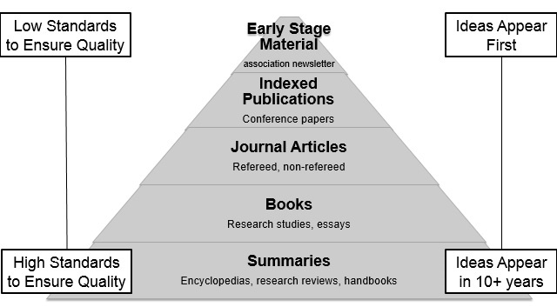
Figure 3.2. A Classification of Sources of Literature Review Materials from Summaries to Early-Stage Materials

Slide 20
Six Step Literature Review: Evaluate and Select the Literature (1 of 2)
Is it a good, accurate source?
  National journal?
  Refereed (peer reviewed) source?
  Research study?
  Include quantitative and qualitative sources

Slide 21
Six Step Literature Review: Synthesize the Literature
Organize important concepts rather than chronology
Might develop a table of major concepts and related literature
Might develop a visual diagram of the literature
It is important to interrelate the concepts

Slide 22
Six Step Literature Review: Writing a Literature Review
Thematic review
  Literature documents the theme identified by researcher
  No study is discussed in detail
Study-by-study review
  Detailed review of each study
  Studies grouped by themes
  Summaries linked by transitional sentences and organized under subheadings

